Slide 1
Introduction to motion
Unit 3
MODULE 1

Slide 2
PRE-ASSESSMENT
10 – 12 minutes only
Choose the letter of the correct answer:
When is an object considered to be in motion?
a. I and II only c. II and III only
b. I and III only d. I, II and III
When its position changes with respect to a point of reference.
When its distance changes with respect to a point of reference.
When its distance changes with respect to a point of reference.

Slide 3
PRE-ASSESSMENT
For item numbers 2 and 3, refer to the table below. Data were obtained from a 200-meter dash competition.
Which of the following statements is/are TRUE?
Female Athlete | Recorded Time (s) | Male Athlete | Recorded Time (s)
1 | 26.5 | 1 | 22.4
2 | 26.1 | 2 | 21.9
3 | 25.3 | 3 | 23.0
4 | 26.7 | 4 | 22.6
The male athletes are faster than the female athletes.
Compared to the speed of the fastest male athlete, the average speed of the fastest
female athlete is slightly less.
I only C. Both I and II
II only D. Neither I nor II

Slide 4
PRE-ASSESSMENT
How do you compute for the average speed of each athlete?
A. divide 200 meters by the recorded time of travel
B. divide the recorded time of travel by 200 meters
C. multiply 200 meters by the recorded time of travel
D. divide 200 meters by twice the recorded time of travel
Which of the following is true about an object that travels 5 meters to the
left, then 2 meters up, then another 5 meters to the right?
A. The displacement of the object is equal to 12 meters
B. The displacement of the object is equal to 12 meters down
C. The total distance travelled by the object is equal to 12 meters
D. The total distance travelled by the object is equal to 12 meters down

Slide 5
PRE-ASSESSMENT
Which of the following statements is NOT TRUE about the object moving with constant speed?
A. The object is not accelerating
B. The speed of the object is equal to zero
C. The distance travelled by the object increases
uniformly
D. The speed of the object remains the same all
throughout the travel

Slide 6
PRE-ASSESSMENT
6. Which of the following graphs show that the object’s
motion is accelerating?
distance
distance
distance
distance
time
time
time
time
A
B
C
D

Slide 7
PRE-ASSESSMENT
The speeds of a bus traveling on a straight road are given in the following table.
Which of the following statement(s) is (are) correct?
Time, t(s) | 0 | 1 | 2 | 3 | 4
Speed, v (m/s) | 0 | 2 | 4 | 6 | 8
The bus travels 16 m in 4s.
The bus travels with an average speed f 4 m/s/s.
The bus travels with a uniform acceleration of 2 m/s/s.
The instantaneous acceleration of the bus is 2 m/s/s.
II only C. III only
II ,III &IV D. III and IV

Slide 8
PRE-ASSESSMENT
8. A learner is studying the constant acceleration of three different cars and
gets the following results:
Which of the following gives the correct relationship about the acceleration of the three cars?
Acceleration of Car A = acceleration of car B = acceleration of car C
Acceleration of Car A > acceleration of car B = acceleration of car C
Acceleration of Car A < acceleration of car B = acceleration of car C
Acceleration of Car A < acceleration of Car B < acceleration of Car C
Car A changes its speeds from 10 m/s to 30 m/s in a time interval of 2 s. Car B changes its speeds from 10 m/s to 40 m/s in a time interval of 3 s. Car C changes its speeds from 10 m/s to 50 m/s in a time interval of 4 s.

Slide 9
PRE-ASSESSMENT
9. What does the slope of a distance vs. time graph represent?
a. acceleration c. distance
b. displacement d. Speed
10. What does the slope of a speed vs. time graph represent?
a. acceleration c. force
b. distance d. speed

Slide 10
Motive questions
When can we say that an object is in motion?
How do we describe the motion of an object?

Slide 11


A video that describes motion

Slide 12
REVIEW
To describe the motion of an object, you must first be able to tell exactly where it is positioned. Describing exact position entails two ideas:
describing how far the object is from the point of reference and;
describing its direction relative to that point of reference.

Slide 13
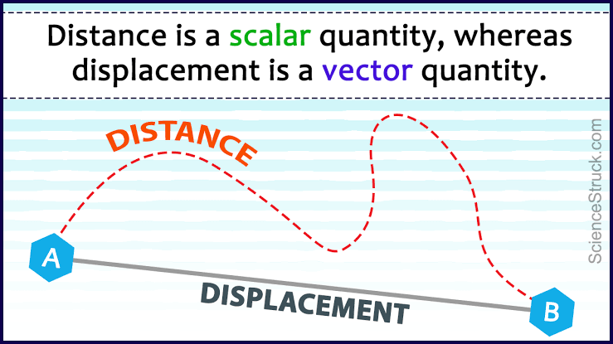
Remove me please!
NO DIRECTION
WITH DIRECTION

Slide 14
Definition of terms
Instruction: Match Column A to column B
are quantities that are fully described by a
magnitude (or numerical value) alone
a scalar quantity that refers to "how much
ground an object has covered" during its motion
c. is a scalar quantity that refers to "how much
ground an object has covered" during its
motion.
it refers to "how far out of place an object is"; it is the object's overall change in position.
1. Distance
2. Displacement
3. Scalar Quantity
4. Vector Quantity
C
B
A
D

Slide 15
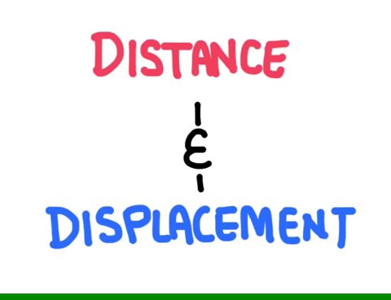
Describing the position of an object

Slide 16
WORD RACE GAME
Instruction: The class will be divided into two groups. Each group will take turns in picking words from the word box and match the word picked in its definition written in the powerpoint presentation.

Slide 17

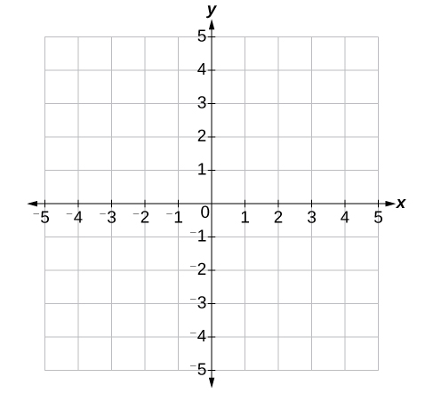
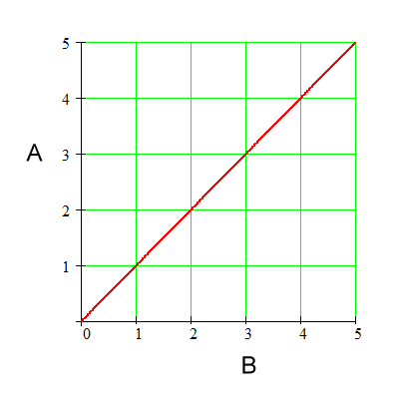
___________________ a simplified drawing showing the appearance, structure, or workings of something; a schematic representation.
______________ is a system that uses one or more numbers, to uniquely determine the position of the points.
______________ a chart showing the relation between variable quantities, typically of two variables, each measured along one of a pair of axes at right angles.

Slide 18
DIAGRAM a simplified drawing showing the appearance, structure, or workings of something; a schematic representation.
COORDINATES is a system that uses one or more numbers, to uniquely determine the position of the points.
GRAPH a chart showing the relation between variable quantities, typically of two variables, each measured along one of a pair of axes at right angles.

Slide 19
ACTIVITY: DESCRIBING THE POSITION OF AN OBJECT
Objective
You should be able to describe in words the position of an object within the room or the school ground.

Slide 20
Procedure
Obtain from your teacher the piece of
paper that describes where you will find the
object.
Q1. Were you able to find the object? Was it
easy or difficult?
Q2. Is the instruction clear and easy to follow?
What made it so?

Slide 21

2. Put back the object to its place,
if you found it. Otherwise, ask your
teacher first where it is located
before you move on to the
next step.
3. Revise the instruction to make it more
helpful. Write it on a separate sheet of
paper and let another group use it to
find the object.

Slide 22
Q3. Were they successful in finding the object?
Was it easy for them or difficult?
Q4. What other details or information included in
your instruction that made it clearer and easier
to follow?
Q5. In your own words, what is point of reference
and how important it is?

Slide 23
DESCRIBING MOTION THROUGH VISUALS

Slide 24
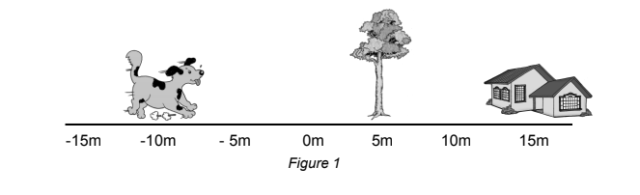
Describing motion through visuals
1. Using diagram
Consider the diagram in Figure 1. The positions of the objects are described
in the diagram by their coordinates along the number line.

Slide 25
Process questions
What is the position of the dog?
What is the position of the tree?
What is the position of the dog with respect to the house?
What is the position of the tree with respect to the dog?

Slide 26
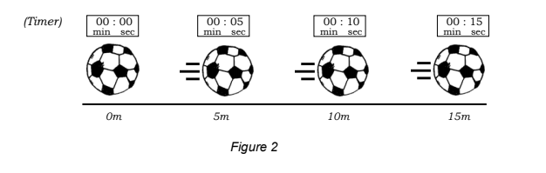
Diagram that describes the ball position
Here is another example. In this diagram, the positions of the ball rolling are
shown at equal intervals of time.

Slide 27
Process questions
What is the initial position of the ball? What is its final position?
What is the position of the ball at 10 seconds?
At what time is the position of the ball equal to 5 meters?

Slide 28
Describing motion through visuals
2. Using graphs

Slide 29
Another way to describe the motion of the ball is by the use of motion graphs. Convert the diagram in figure 2 to graph by following the guide below:
Fill up Table 1 using the date in Figure 2 above. Note that the positions of the ball are shown every 5 seconds
Table 1: POSITION OF THE BALL VS TIME
Time (s) | Position of the ball (m)
0 | 0

Slide 30
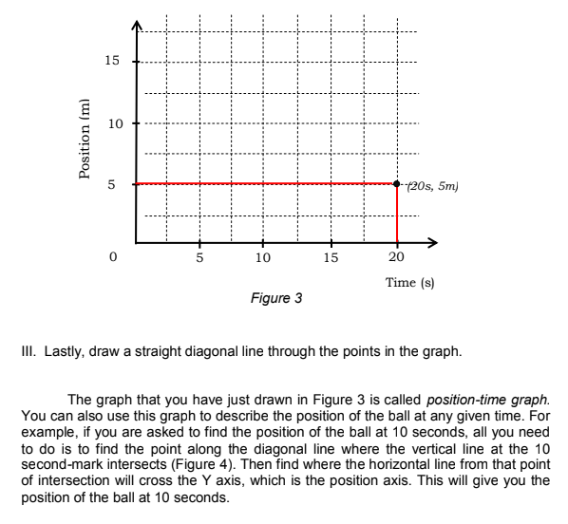
Describing motion through visuals
Plot the values in Table 1 as points on the graph in Figure 3. Note that TIME is plotted on the X- axis while POSITION is plotted on the Y-axis. An example is given below:

Slide 31
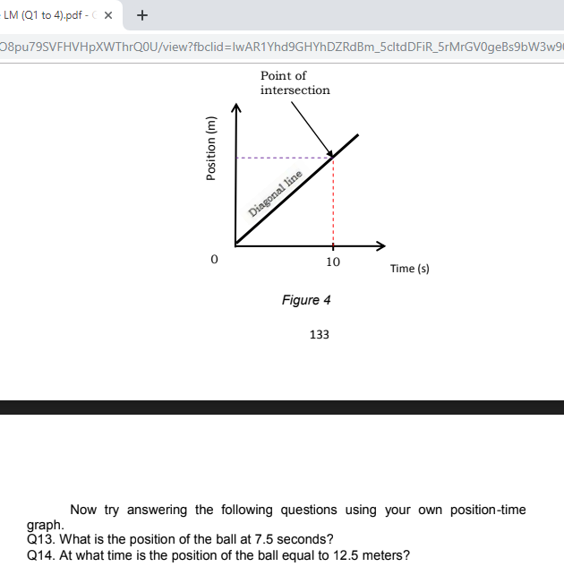
Lastly, draw a straight diagonal line through the points in the graph.
The graph that you have just drawn in Figure 3 is called POSITION – TIME graph. You can also use this graph to describe the position of the ball at any given time. For example, if you are asked to find the position of the ball at 10 seconds, all you need to do is to find the point along the diagonal line where the vertical line at the 10 second-mark intersects (Figure 4). Then, find where the horizontal line from the point of intersection will cross the Y axis, which is the position axis. This will give you the position of the ball at 10 seconds.

Slide 32

Now try answering the following questions using your own position-time graph:
Q13. What is the position of the ball at 7.5 seconds?
Q14. At what time is the position of the ball equal to 12.5 meters?

Slide 33
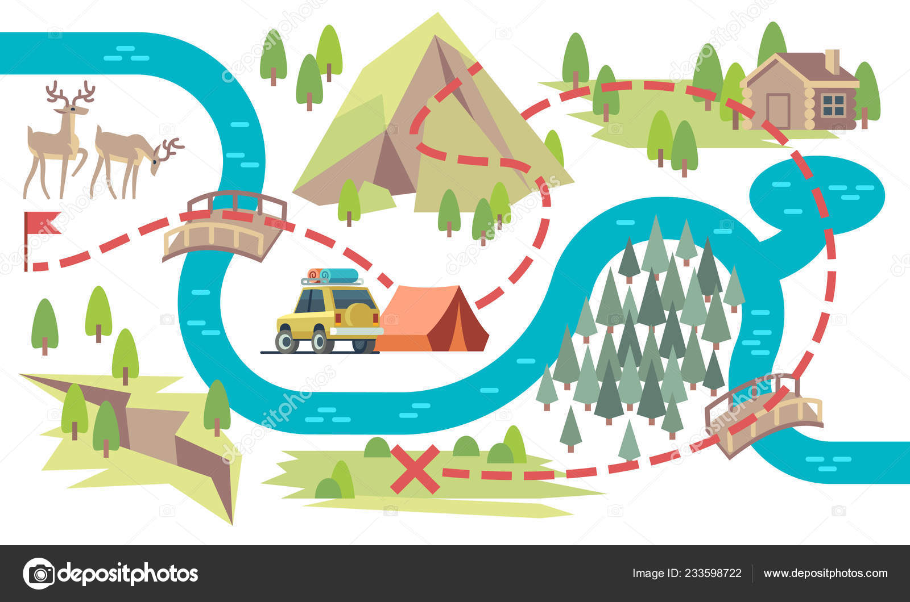
ACTIVITY: MY HOME TO SCHOOL ROADMAP
START
FINISH

Slide 34
ACTIVITY: MY HOME TO SCHOOL ROADMAP
Objective: In this activity, you should be able to make a roadmap that shows
how to get to school from your home.
Procedure:
1. Devise a way to easily measure distance. Let your teacher check your
non-standard measurement for precision.
2. Using your measuring device, gather the data that you will need for
your roadmap. Make sure that you take down notes of all names of the
roads, landmarks, corners, posts, and establishments you pass by.
Record your data properly.

Slide 35
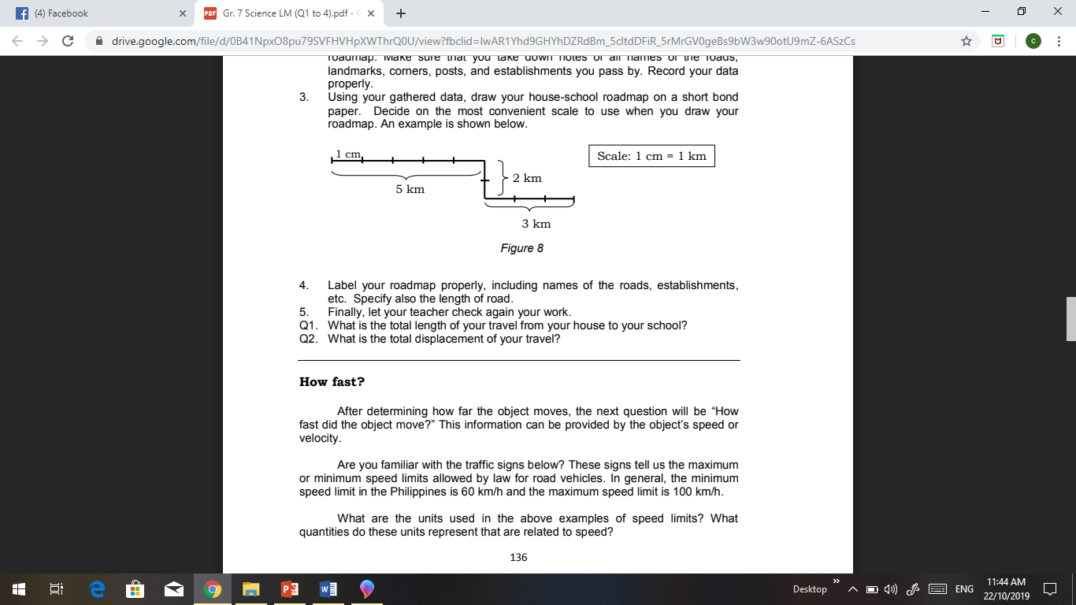
3. Using your gathered data, draw your house-school roadmap on a short
bond paper. Decide on the most convenient scale to use when you
draw your roadmap. An example is shown below:

Slide 36
4. Label your roadmap properly, including names of the roads,
establishments, etc. Specify also the length of the road.
5. Finally, let your teacher check again your work.
Questions:
Q1. What is the total length of your travel from your house to your school?
Q2. What is the total displacement of your travel?

Slide 37
ACTIVITY: FUN WALK

Slide 38

FUN WALK

Slide 39
ACTIVITY : fun walk
Objective: In this activity, you should be able to gather data to determine
who walks fastest.
Procedure:
1. Start by choosing a spacious place to walk straight.
2. Half of the group will walk while the other half will observe and record
data.
3. Mark on the ground the starting line. All participants must start from the
starting line at the same time.

Slide 40
4. Upon receiving the go signal, all participants must start to walk as fast as they could. The other members should observe closely as the
participants walk and determine who walks fastest.
5. Repeat #4 but this time, collect data to support your conclusion. Discuss
within your group how you are going to do this.
Questions:
Q1. What quantities did you measure for your data?
Q2. How did you combine these qualities to determine how fast each
participant was walking?
Q3. How did you use the result to determine who walked fastest?

Slide 41
SHOW me more please
Speed
Speed and direction
Constant speed vs. instantaneous speed

Slide 42

speed

Slide 43

Speed and direction

Slide 44

Constant speed vs instantaneous speed

Slide 45
Activity : doing detective work

Slide 46
Consider this situation below:
Supposed you were having your on-the-job training in a private investigating company. You were asked to join a team assigned to investigate a ‘hit and run’ case. The alleged suspect was captured by the CCTV camera driving down a road leading to the place of incident.

Slide 47
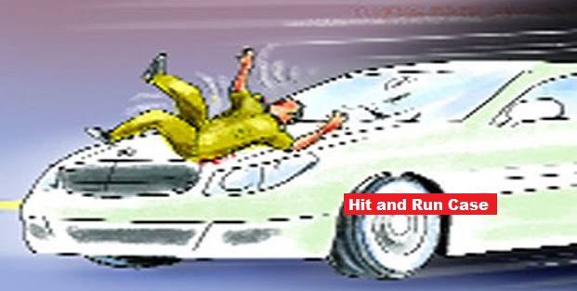

Slide 48
The suspect denied the allegation, saying that he was then driving very slowly with a constant speed. Because of the short time difference when he was caught by the camera and when the accident happened,

Slide 49
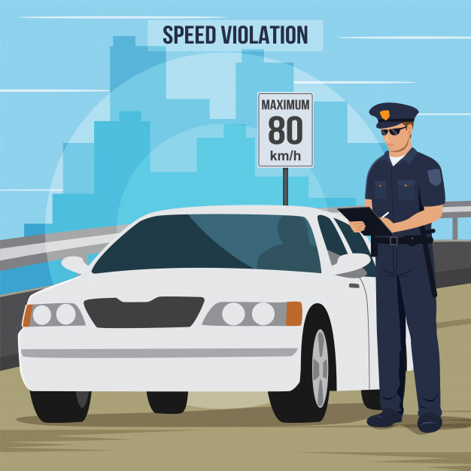

Slide 50
he insisted that it was impossible that he would already be at the place when the crime happened. But when you were viewing the scene again on the camera, you noticed that his car was leaving oil spots on the road. When you checked these spots on site, you found out
that they are still evident.

Slide 51
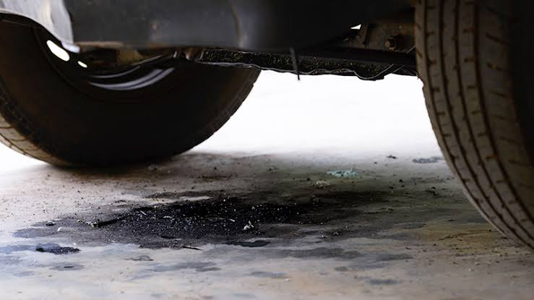
Oil spots

Slide 52
So you began to wonder if the spots can be used to investigate the motion of the car of the suspect and check whether he was telling the truth or not. Here is an activity that you can do to help you with your investigation.

Slide 53
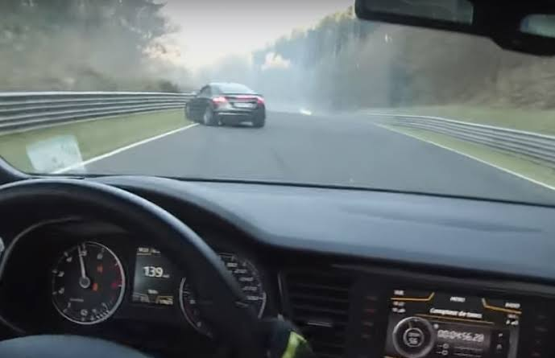
Mission:
To investigate the motion of the car

Slide 54
You will analyze the motion using strips of papers with dots. For this activity, assume that the dots represent the ‘oil drops’ left by the car down the road.

Slide 55
analyze the motion using strips of papers with dots

Slide 56
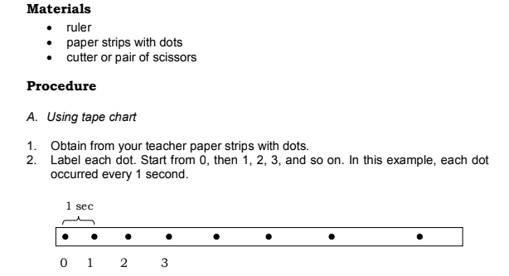
Materials needed:
1. ruler
2. paper strips with dots
3. cutter or pair of scissors
Procedure:
A. Using tape chart
1. Obtain from your teacher paper strips with dots.
2. Label each dot. Start from 0, then 1,2,3, and so on. In this
example, each dot occurred every 1 second.
3. Examine the distances between successive dots.
Figure: Tape chart

Slide 57
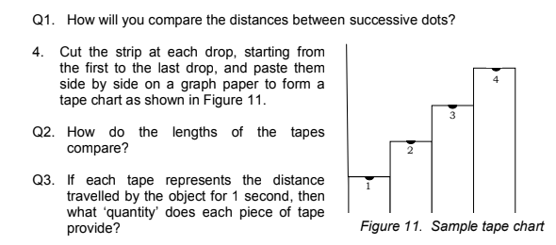
Questions:
Q1. How will you compare the distances between successive
dots?
Procedure:
4. Cut the strip at each drop, starting from the first
to the last drop and paste them side by side on
a graph paper to form a tape chart as shown in
Figure below.
Q2. How do the lengths of the tapes compare?
Q3. If each tape represents the distance travelled
by the object for 1 second, then what quantity
does each piece of tape provide?
:
Figure: Tape chart sample

Slide 58
Questions:
Q4. What does the chart tell you about the speed of the car?
The difference in length between two successive tapes
provides the object’s ACCELERATION or its change in speed or
velocity for a time interval of 1 second.
Q5. How will you compare the changes in the lengths of two
successive tapes?
Q6. What then can you say about the acceleration of the moving car?

Slide 59
Procedure:
B. Using motion graphs
5. Measure the distance travelled by the car after 1 second, 2
seconds, and so on by measuring the distance between drops 0 and 1, 0 and 2, and so on. Enter your measurements
in Table 3.
Time of Travel (s) | Distance travelled (m)
1
2
3
4
5
Table: Measurement

Slide 60
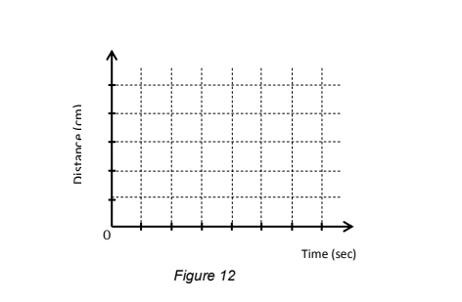
Procedure:
B. Using motion graphs
6. Plot the values in Table 3 as points on the graph in the Figure
below .
Distance (cm)
Time (sec)
Figure: Distance-time graph
Questions:
Q7. How does your distance-time graph look like?

Slide 61
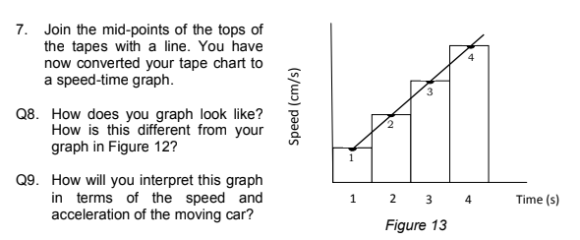
Procedure:
7. Join the mid-points of the tops of the
tapes with a line. You have now
converted your tape chart to a speed- time graph.
Figure: Speed-time graph

Slide 62
Questions:
Q8. How does your distance-time graph look like?
Q9. How will you interpret this graph in terms of the speed
and acceleration of the moving car?
Q10. If you found out in your investigation that the
arrangement of oil drops left by the car is similar to
what you used in this activity, was the suspect telling
the truth when he said that he was driving with
constant speed?

Slide 63

To summarized what you have learned
If an object does not change its position at a given time interval, then it is at rest or its speed is zero or not accelerating.
At rest, speed is zero

Slide 64
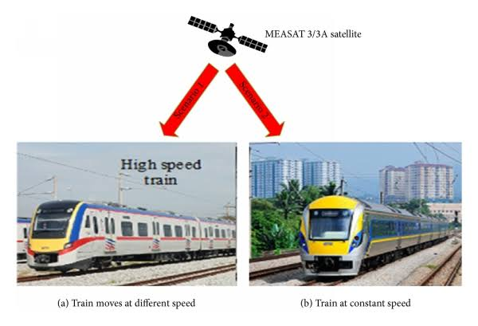
To summarized what you have learned
If an object covers equal distance at equal intervals of time, then it is moving at constant speed and still not accelerating.
Train moving in equal distance at equal intervals of time, in constant speed and not accelerating

Slide 65
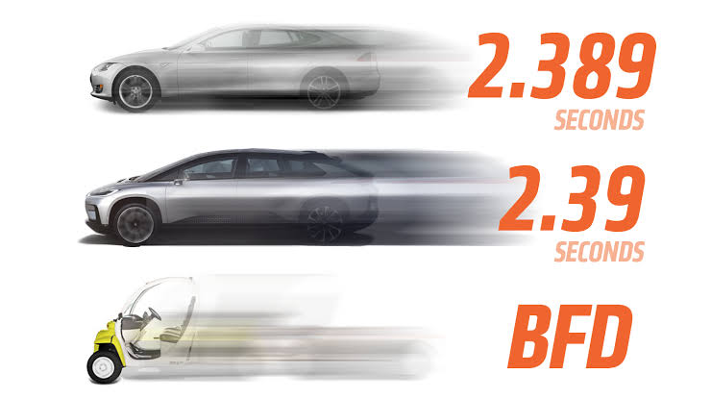
To summarized what you have learned
If an object covers varying distances at equal intervals of time, then it is moving with changing speed or velocity. It means that the object is accelerating.
Car moving with changing speed or velocity, car is accelerating

Slide 66
Summative test
Instruction: Match Column A to column B
are quantities that are fully described by a
magnitude (or numerical value) alone
a scalar quantity that refers to "how much
ground an object has covered" during its motion
are quantities that are fully described by both a
magnitude and a direction
a vector quantity that refers to "how far out of
place an object is"; it is the object's overall
change in position.
1. Distance
2. Displacement
3. Scalar Quantity
4. Vector Quantity

Slide 67
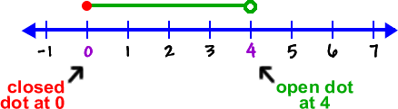
Summative test
Instruction: Fill in the blanks with the correct answer. The correct answers will be taken from
the box.
DIAGRAM
____________5. is a system that uses one or more numbers, to uniquely determine the position of the points.
____________ 6. a chart showing the relation between variable quantities, typically of two variables, each measured along one of a pair of axes at right angles.
_____________7. a simplified drawing showing the appearance, structure, or workings of something; a schematic representation.
COORDINATES
GRAPH
INTERVALS

Slide 68
Summative test
Write the letter of the correct answer.
_______8. If an object does not change its position at a given time interval, then it is at rest or accelerating and its speed is_______ :
a. One c. Two
b. Zero d. Six
_______9. If an object covers equal distance at equal intervals of time, then it is moving
at ________________.
a. Constant speed c. Instantaneous speed
b. Acceleration d. Not in constant speed

Slide 69
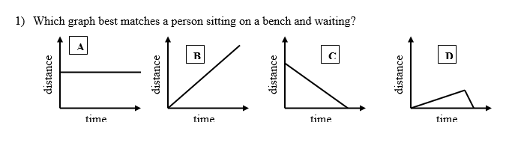
Summative test
Write the letter of the correct answer.
10. Which graph best matches a person sitting on a bench and waiting?

Slide 70
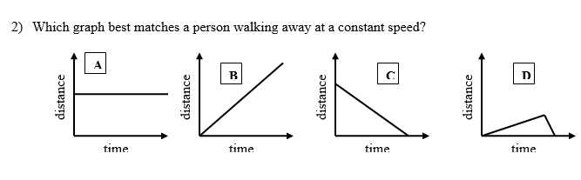
Summative test
Write the letter of the correct answer.
11. Which graph best matches a person walking at a constant speed?

Slide 71
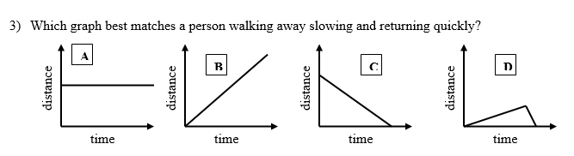
Summative test
Write the letter of the correct answer.
12. Which graph best matches away slowing and returning quickly?

Slide 72
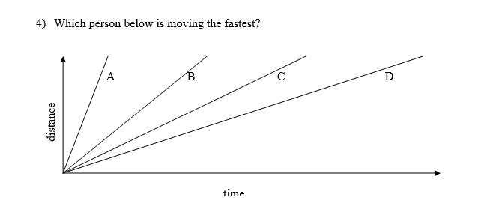
Summative test
Write the letter of the correct answer.
13. Which person below is moving the fastest?

Slide 73
Summative test
Write the letter of the correct answer.
A duck flies 60 meters in 10 seconds. What is the duck’s speed?
a. 600 m/s
b. 50 m/s
c. 6 m/s
d. 70 m/s
A beetle crawls 2 cm/minute for ten minutes. How far did it crawl?
a. 8 centimeters c. .20 centimeters
b. 5 centimeters d. 20 centimeters

Slide 74
Summative test
Write the letter of the correct answer.
16. A force is described as…..
a. A push only
b. A pull only
c. A push or a pull
d. None of the above
17. What unit do scientists use to measure force?
a. Newton c. Meters
b. Grams d. Meter per second

Slide 75
Summative test
Write the letter of the correct answer.
18. What does the slope of a distance vs. time graph represent?
a. acceleration c. distance
b. displacement d. Speed
19. What does the slope of a speed vs. time graph represent?
a. acceleration c. force
b. distance d. speed

Slide 76
Summative test
Write the letter of the correct answer.
When you slide a box across the floor, what force will be
stronger that your own push?
a. Support force
b. Friction force
c. Gravity
d. Air resistance

Slide 77
Summative test
Write the letter of the correct answer.
Elsa is sitting very still on a chair. But Jose claims that Elsa is
actually moving. Jose is true if the point of reference is the ________?
a. chair
b. floor
c. Earth
d. Sun

Slide 78
ANSWER KEY
Pre Test
D
C
A
C
B
C
D
A
D
A
Summative Test
B 11. A
D 12. D
A 13. A
C 14. C
Interval 15. B
Coordinates 16. C
Graph 17. A
B 18. D
A 19. A
A 20. D

Slide 79
Prepared for:
Project e-Unlock
Prepared by:
C.I. TORCH Team
San Vicente National High School
San Vicente, Butuan City
Members:
1. Cultura, Erlinda E.
2. Pham, Jayne P.
3. Moreno, Ma. Theresa U.
4. Salinas, Gliceria A.
5. Sulapas, Maricel P.
School Head:
Emma C. Ulbis, PhD.
Coach:
Marie Joy M. Intong

